Slide 1
Shell Bootcamp 2024 3 Reflections for Week #3
Khushi Garg
Date : 13-sept-2024

Slide 2

About Me
Stay vigilant, trust but verify, and protect what matters.

Slide 3

My learnings from this week!

Slide 4
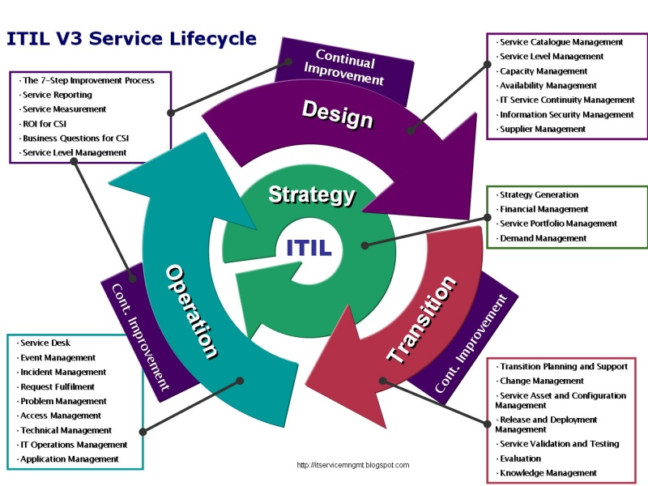
Learning 1 | My takeaways
Key learning
The Information Technology Infrastructure Library (ITIL) is a set of best practices for IT service management (ITSM) that helps align IT services with business needs. ITIL is structured around the service lifecycle, which includes five stages:
Service Strategy
Service Design
Service Transition
Service Operation
Continual Service Improvement

Slide 5
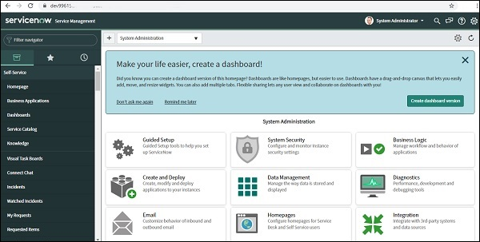
Learning 2 | My takeaways
Key learning
ServiceNow is a powerful platform designed to streamline and automate various business processes. It excels in IT Service Management (ITSM), helping organizations efficiently manage incidents, problems, changes, and requests. Beyond IT, ServiceNow supports HR processes, customer service management, security operations, and custom business applications. Its workflow automation and real-time analytics capabilities enhance operational efficiency and decision-making.

Slide 6
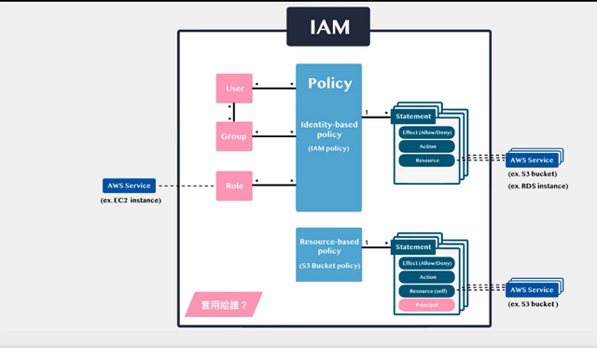
Learning 3 | My takeaways
Key learning
AWS Identity and Access Management (IAM) is a crucial service for securely managing access to AWS resources. It allows you to create and manage users, groups, and roles, and set permissions to control who can access what. With features like multi-factor authentication (MFA) and temporary security credentials, IAM enhances security by ensuring that only authorized users can perform specific actions.

Slide 7

Relevance of learnings for my organization

Slide 8
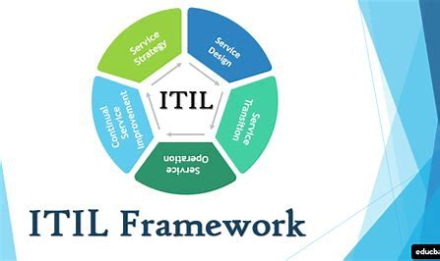
Learning 1 | Relevance for Shell
How I feel Shell implements this learning and How I feel Shell benefits from this learning
Shell implements the ITIL framework to enhance IT service management by aligning IT services with business goals. This leads to improved efficiency, reduced costs, and better risk management. The benefits include increased productivity, higher customer satisfaction, and streamlined operations.

Slide 9
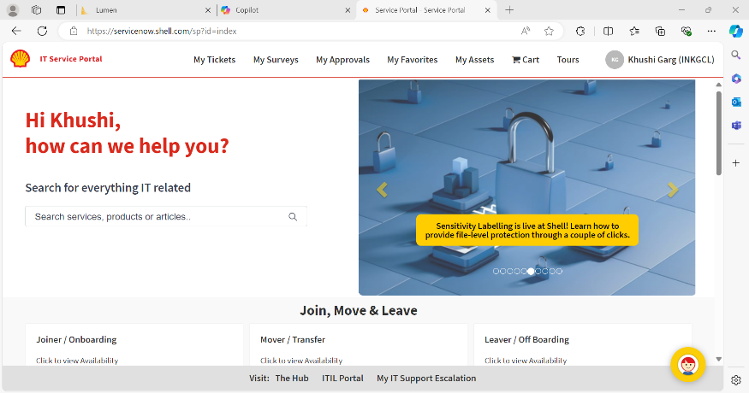
Learning 2 | Relevance for Shell
How I feel Shell implements this learning and How I feel Shell benefits from this learning
Shell uses ServiceNow to streamline IT service management by replacing multiple tools with a unified platform. This enhances efficiency, reduces costs, and improves data control. The benefits include better automation, improved user experience, and more reliable operations¹².

Slide 10
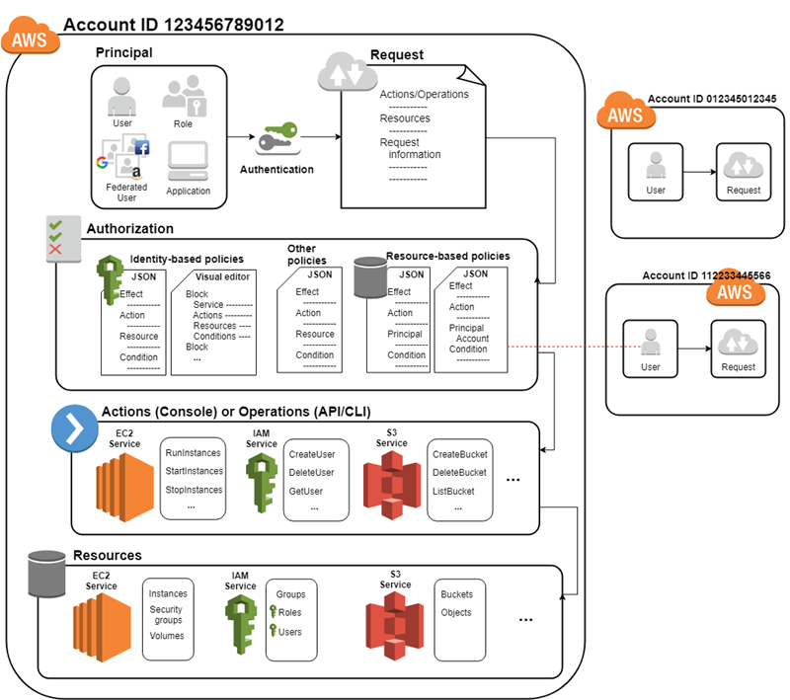
Learning 3 | Relevance for Shell
How I feel Shell implements this learning and How I feel Shell benefits from this learning
Shell implements AWS IAM to manage access to AWS resources securely. By using IAM, Shell can control user permissions, enforce security policies, and ensure compliance. The benefits include enhanced security, streamlined access management, and improved operational efficiency.

Slide 11

Challenges in implementing learning

Slide 12
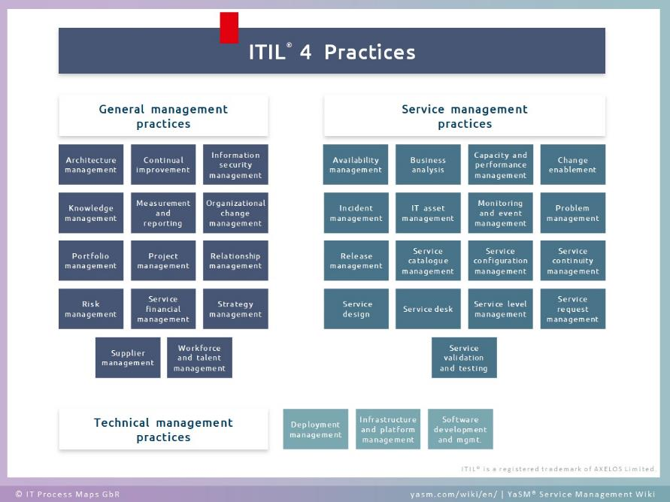
Challenge faced while implementing Learning 1
What were the challenges I faced while implementing Learning 1 and my plan to overcome them
During training, I encountered challenges with the ITIL framework, such as resistance to change, lack of resources, and poor communication. To overcome these, Shell conducted comprehensive training sessions, secured necessary funding, established clear communication channels, and engaged leadership early to highlight ITIL’s benefits.

Slide 13
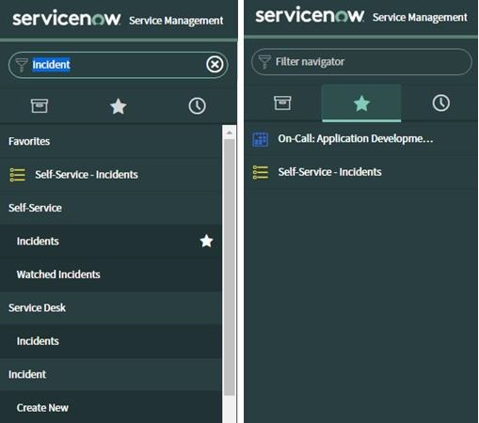
Challenge faced while implementing Learning 2
What were the challenges I faced while implementing Learning 2 and my plan to overcome them
During the implementation of ServiceNow at Shell, I challenges included resistance to change, lack of expertise, complicated workflows, and over-customization. To address these, Shell conducted training sessions, invested in skill development, streamlined workflows, and limited customization to essential features, ensuring a smoother transition and improved efficiency.

Slide 14
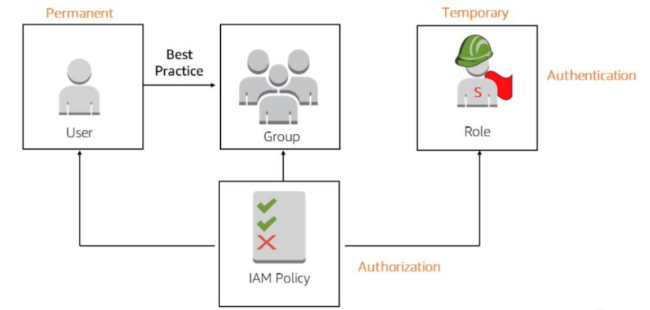
Challenge faced while implementing Learning 3
What were the challenges I faced while implementing Learning 3 and my plan to overcome them
Implementing AWS Identity and Access Management (IAM) can be challenging due to the complexity of managing policies and ensuring security best practices. To overcome these challenges, start with AWS managed policies and gradually move to custom ones, using the IAM Policy Simulator to test them. Regularly review and audit policies to ensure least privilege and use tools like AWS IAM Access Analyzer.

Slide 15

Action Plan

Slide 16
My Action Plan for this Week
Actions
Timeline
Status
Creating the Virtual Machine in Azure.
Learning how to work with Kubernetes and chef.
Networking with colleagues.
1 Week
Ongoing

Slide 17

Learning is also Fun!

Slide 18

Learning is also Fun!
My learning was fun this week because of the following reasons:
Group activity
In-class presentations
Assessments and Quiz
Playing Games
Networking with colleagues

Slide 19

Summary
The ITIL Framework is a set of best practices designed to align IT services with the needs of businesses. It emphasizes the Service Value System (SVS), which integrates various inputs to create value. The framework also includes the Four Dimensions Model, covering organizations, technology, partners, and processes to ensure a holistic approach to IT service management.
ServiceNow is a cloud-based platform that provides IT service management solutions built on the ITIL framework. It helps organizations manage digital workflows, including incident and problem management to handle disruptions and identify root causes. Additionally, ServiceNow’s change management capabilities ensure that changes are implemented smoothly and efficiently, minimizing the impact on business operations.
AWS Identity and Access Management (IAM) is a web service that helps you securely control access to AWS services and resources. It allows you to manage users and groups, assign permissions to control access, and enhance security with multi-factor authentication (MFA). AWS IAM ensures that only authorized users can access specific resources, providing a robust security framework for your AWS environment.

Slide 20
Thank You

